Slide 1

Impact of World Cup on Winning Countries
By: Julia Nordbakk, Patrick McKinney, Sheilja Gandhi, Tega Ileleji
Notes:
Tega

Slide 2
Impact of World Cup on Winning Countries
Purpose: Winning the world cup gives the country fame and glory, but we were interested in analyzing how this actually affects the country in short term and long term.
Focus Elements:
Emotional Impact
Economic Impact
Tourism
Target Winning Countries:
Germany 2014
Spain 2010
Italy 2006
Brazil 2002
Notes:
TEGA
Project Description: Winning the world cup gives the country fame and glory, but we were interested in analyzing how this actually affects the country in short term and long term.
Why?
Our assessment will focus on two aspects:
1.Emotional impact
2. Economic impact
Scope:
Germany 2014
Spain 2010
Italy 2006
Brazil 2002
Struggle finding data!!

Slide 3
Determinants of Analysis
Control Countries:
United States
China
Japan
United Kingdom
France
India
Canada
Korea, Rep.
Russian Federation
Australia
Mexico
Indonesia,
Turkey
Netherlands
Switzerland
Saudi Arabia
Notes:
PATRICK
Control countries:
United States, China, Japan, United Kingdom, France, India, Canada, Korea, Rep., Russian Federation, Australia, Mexico, Indonesia, Turkey, Netherlands, Switzerland, Saudi Arabia
Description of how we choose countries and data cleaning process

Slide 4
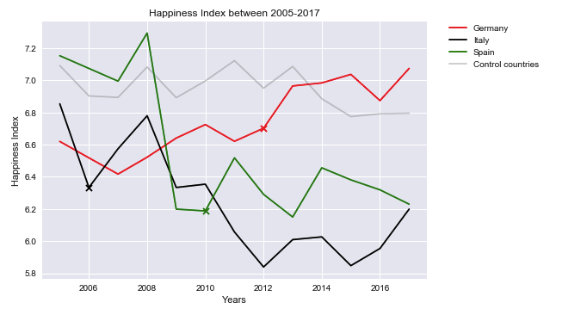
Emotional impact: Does winning the world cup boost morale and increase happiness in that country?
We see a short-lived boost in happiness index followed by a gradual drop on the following years
Control countries line is much higher, which was caused by outlier countries Canada, Switzerland and Netherlands, who have high level of happiness.
Notes:
JULIA
Emotional impact
Does winning the world cup boost morale and increase happiness in that country? country?
Short-lived boost in happiness index that seems to be followed by a gradual let down as perhaps people realize that even a World Cup win won't solve all the country's problems.
Control countries line is much higher, which was caused by outlier countries Canada, Switzerland and Netherlands, who have high level of happiness.
Short-lived boost in happiness index that seems to be followed by a gradual let down as perhaps people realize that even a World Cup win won't solve all the country's problems.

Slide 5
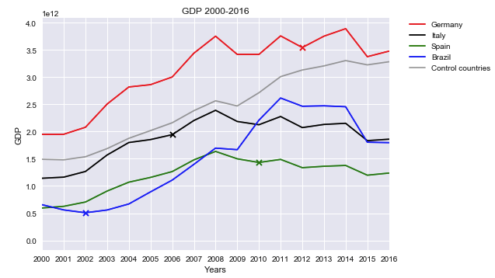
Economic impact: Does winning world cup boost spending and benefit economy in short and long run?
There seems to be a short boost in GDP for the winning countries
The single exception is in 2010, when Spain's GDP grew by only 0.1 percent, as the country was in the middle of a recession.
Notes:
Tega
Does winning world cup boost spending and benefit economy in short and long run?
There seems to be a short boost in GDP for the winning countries
The single exception is in 2010, when Spain's GDP grew by only 0.1 percent, as the country was in the middle of a recession.

Slide 6
Economic impact: Does winning world cup boost tourism industry in the country?
Our assessment focused on:
Number of arrivals at that country- Air transport, number of passengers carried
Revenue from Tourism- Tourist receipts
Google Trend Searches- number of searched for “Travel” and winning country
Data Limitations:
“Number of travelers” file only had data starting in 2005. Therefore we were not able to include Brazil (2002 win) in this analysis.
Similarly, Google Trend data was only available going back to 2004
Notes:
Sheilja

Slide 7
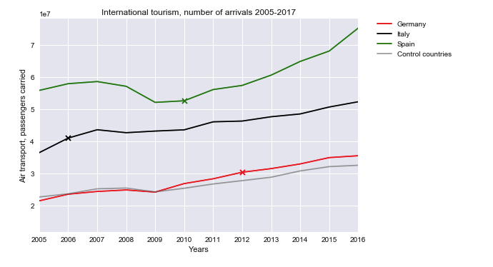
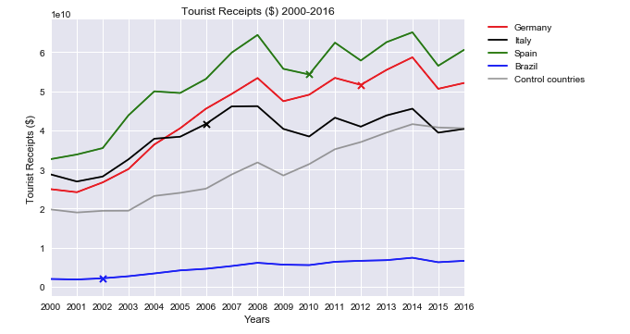
Economic impact: Looking at number of arrivals - Air transport, number of passengers carried
Similar to previous analysis, we are seeing a short spike that doesn’t last
We need to consider that the Tourist Receipts data is in USD and Brazil’s weak currency effects the results we see
Notes:
Sheilja

Slide 8
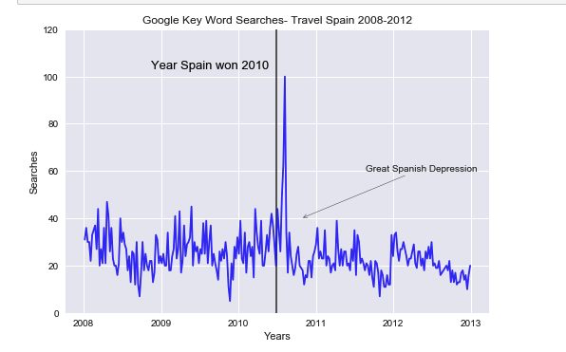
Economic impact: Effect on Tourism- Google Searches “Travel”
We see a huge spike after world cup win, followed by a decline that is just as large.
Spain was going through a recession from 2008-2014, which could explain the huge drop after 2010
Notes:
Julia

Slide 9
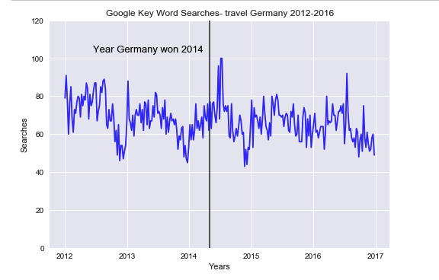
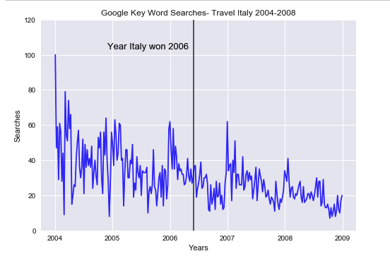
Economic impact: Effect on Tourism- Google Searches “Travel”
We can also see a short spike in Google searches for “Germany Travel” and “Italy Travel” after they won the world cup
Notes:
Julia

Slide 10
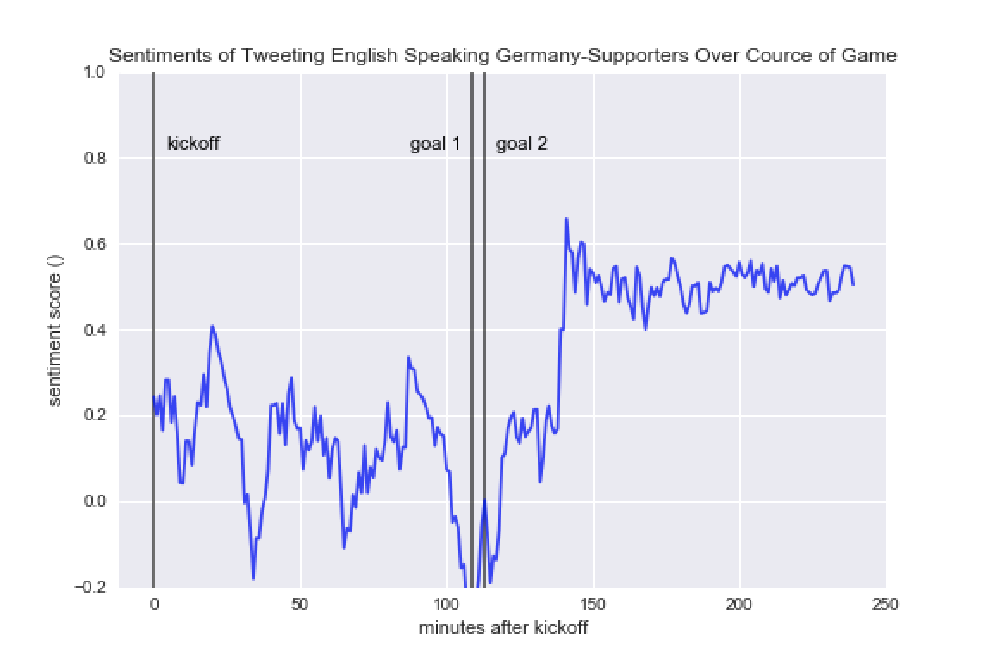
Twitter Sentiment Analysis: @DFB_Team_EN
Notes:
Patrick

Slide 11
Conclusion
We see a short-lived boost in the economy and happiness in the winning country, that seems to be followed by a gradual let down as perhaps people realize that even a World Cup win won’t solve all the country’s problems.
“Think of it as a national equivalent of a sugar rush, with a short-loved energy spike followed by that energy bottoming out.” (Forbes Article)
Notes:
Sheilja

